Slide 1
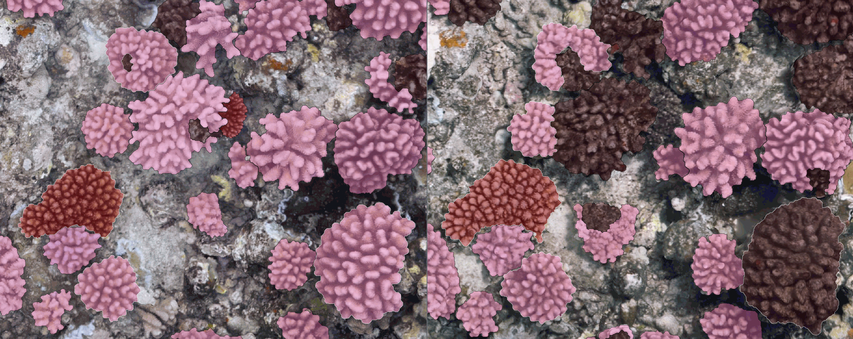
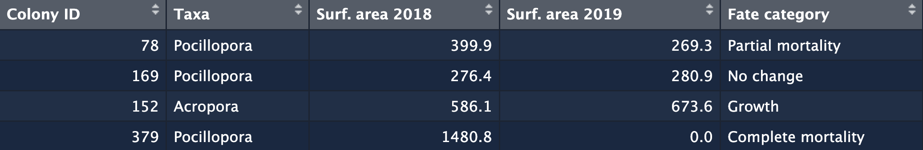
Figure 1
2018
2019
10 cm
78
Partial mortality
169
No change
152
Growth
379
Complete mortality

Slide 2
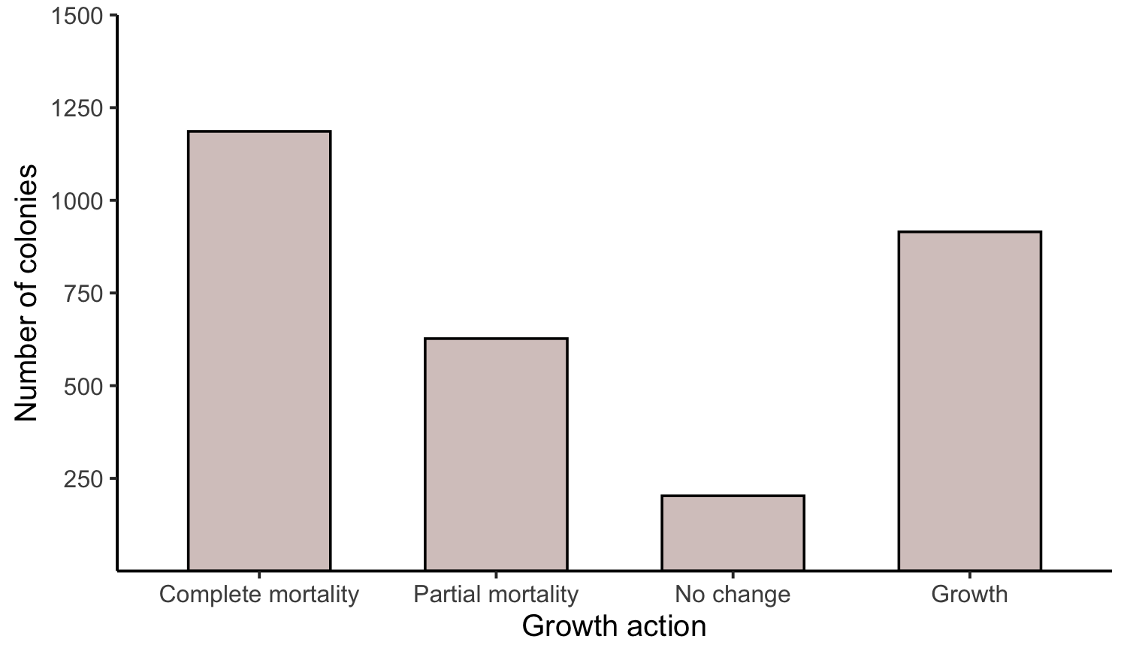
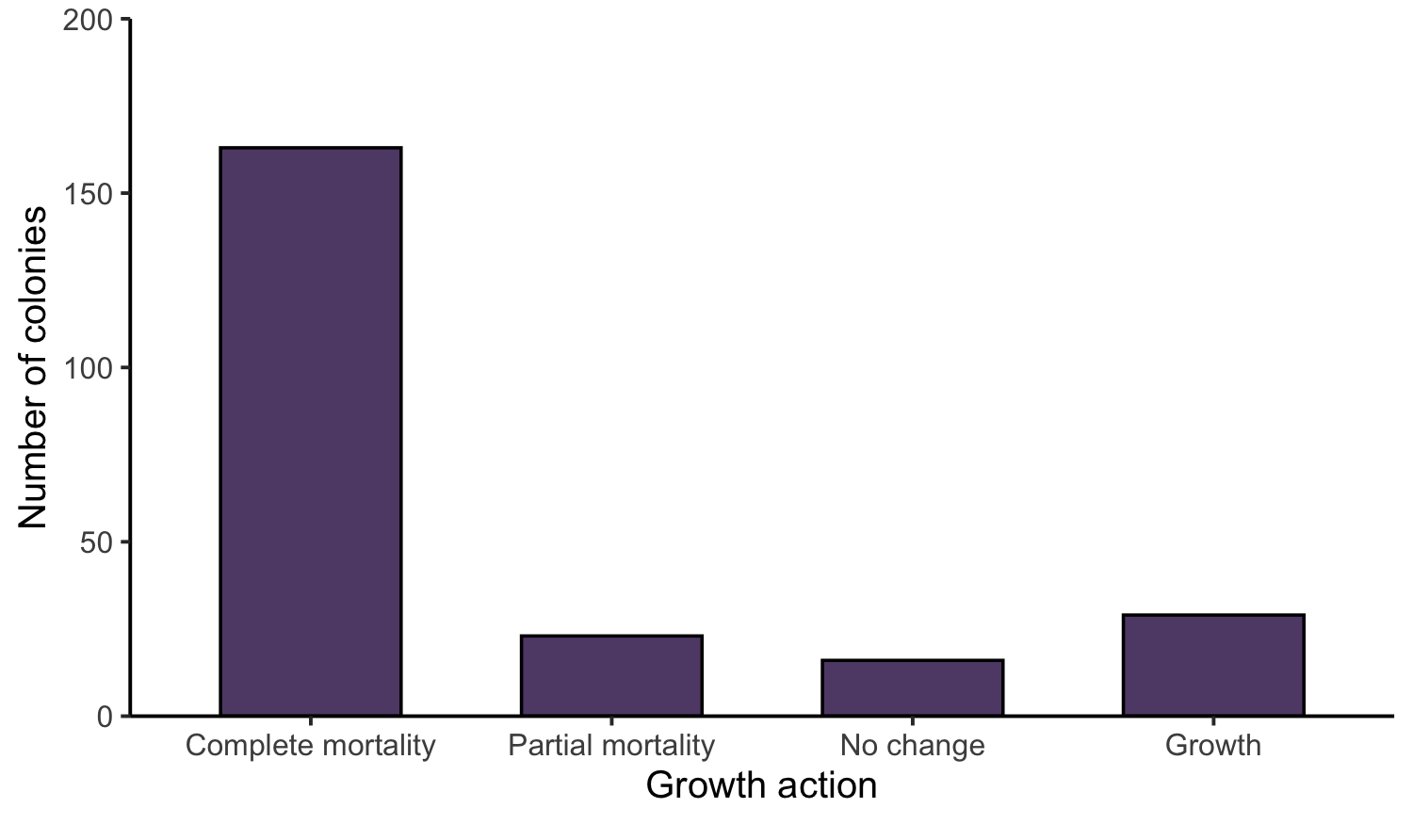
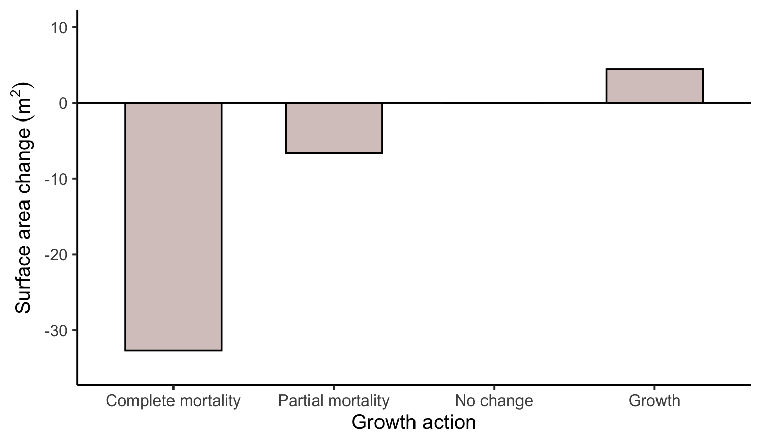
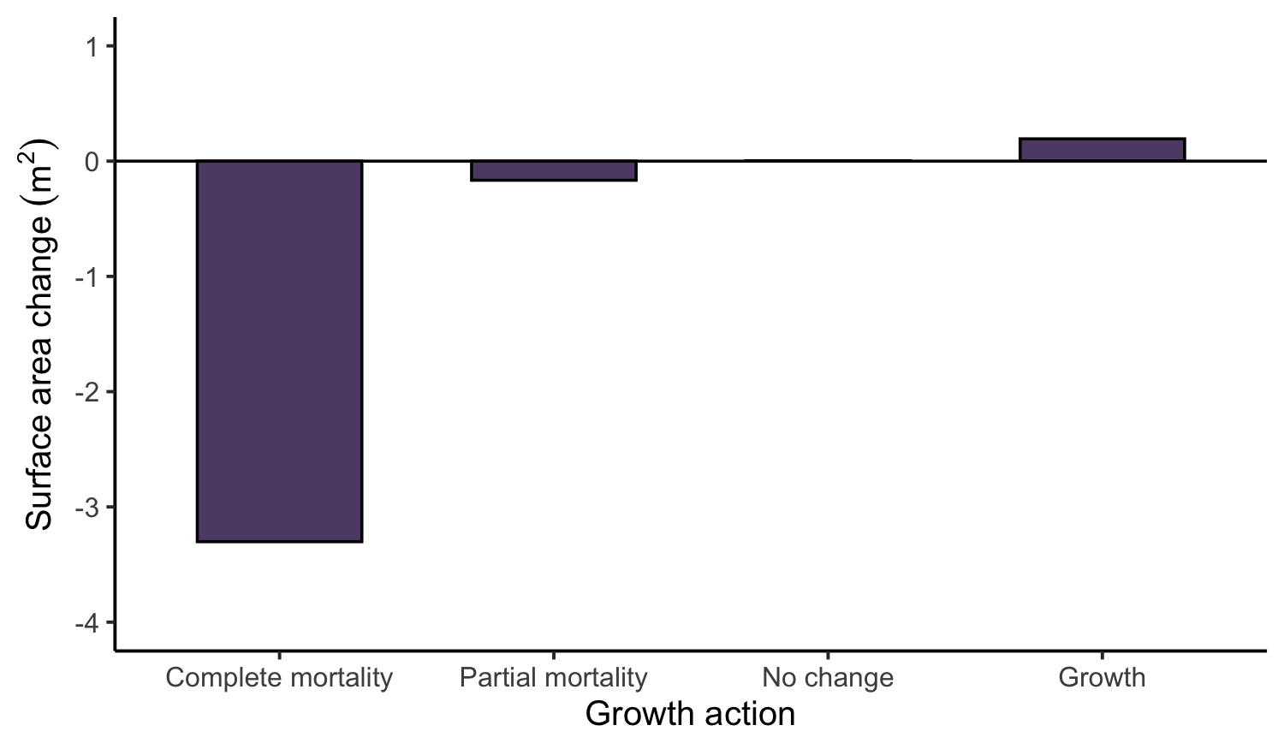
Figure 2
Pocillopora (N = 2931)
Acropora (N = 231)
Number of colonies
Change in surface area (m²)
Type of change
Type of change

Slide 3
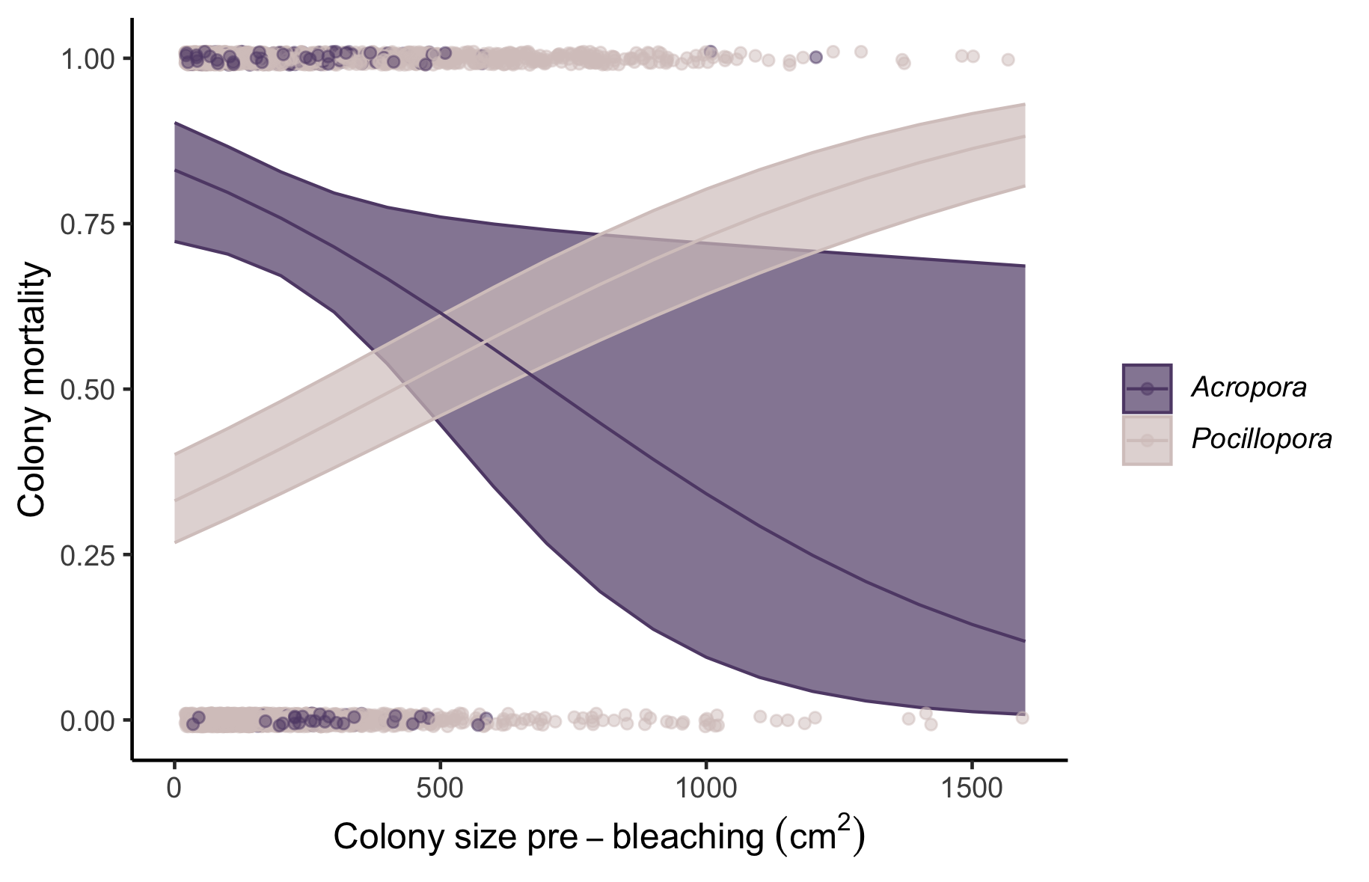
Figure 3
All colonies with live tissue > 50% considered to have survived

Slide 4
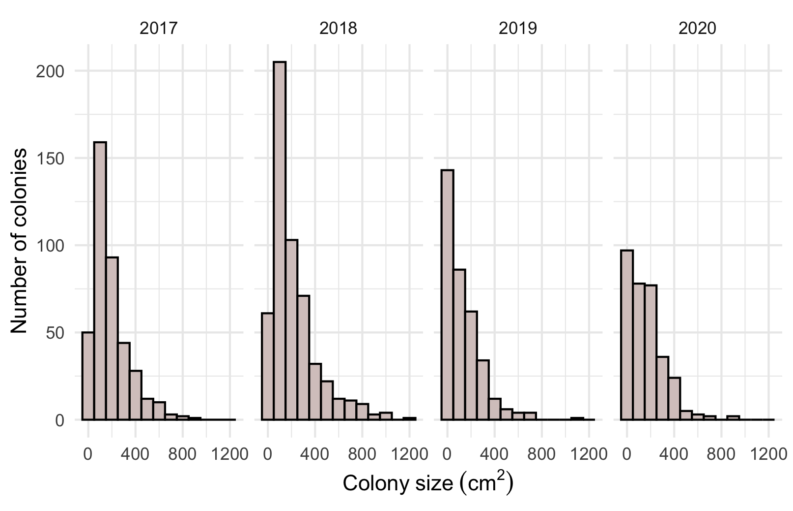
Figure 6
2017 (n = 402)
2018 (n = 534)
2019 (n = 352)
2020 (n = 324)

Slide 5
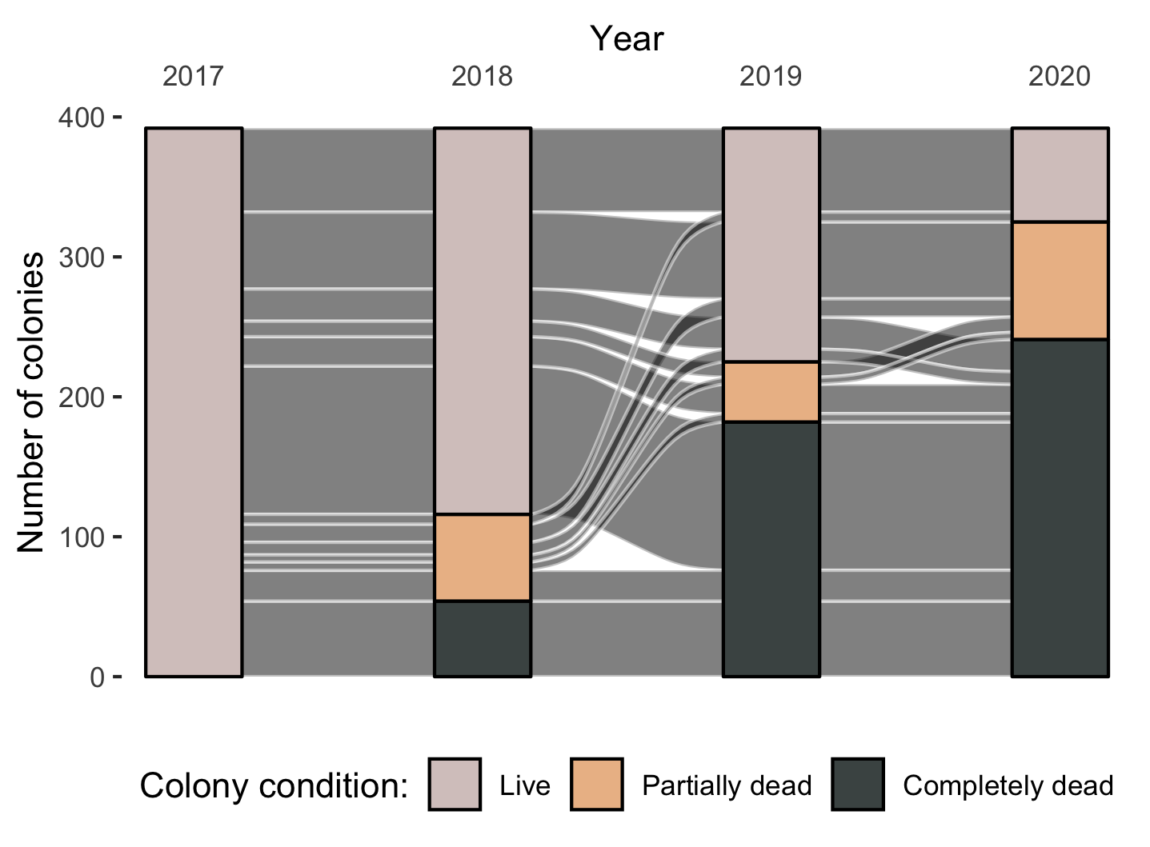
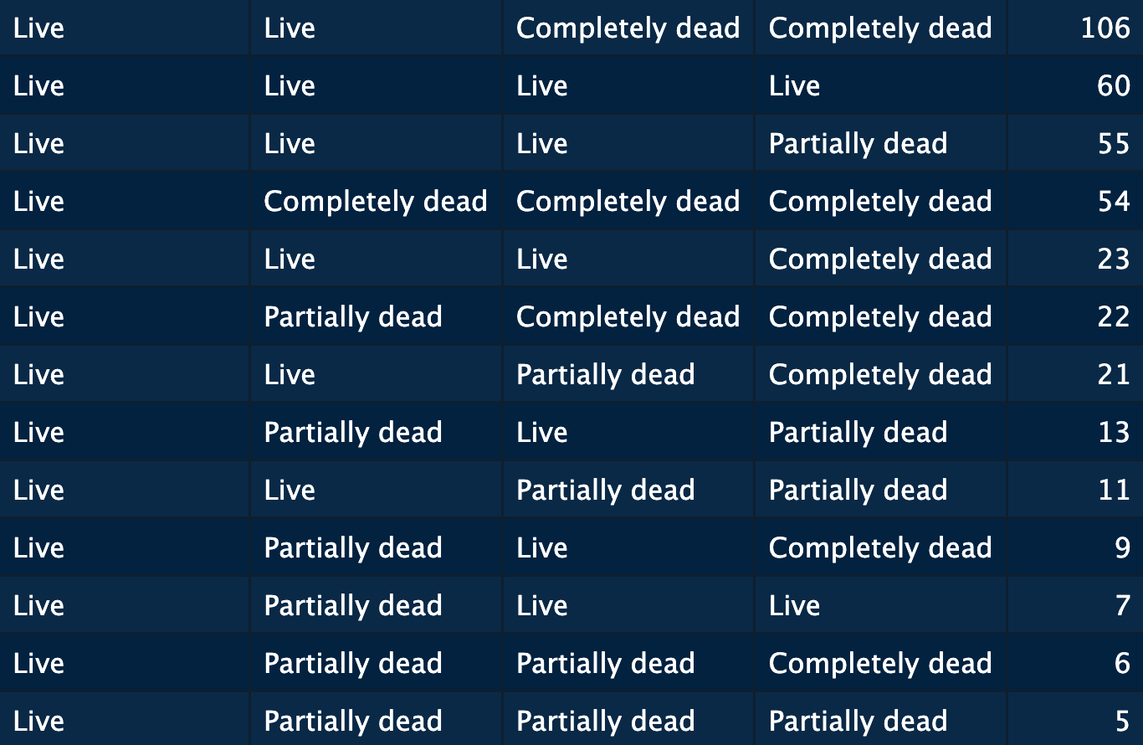
Figure 5
2017
2018
2019
2020
2017
2018
2019
2020
n

Slide 6
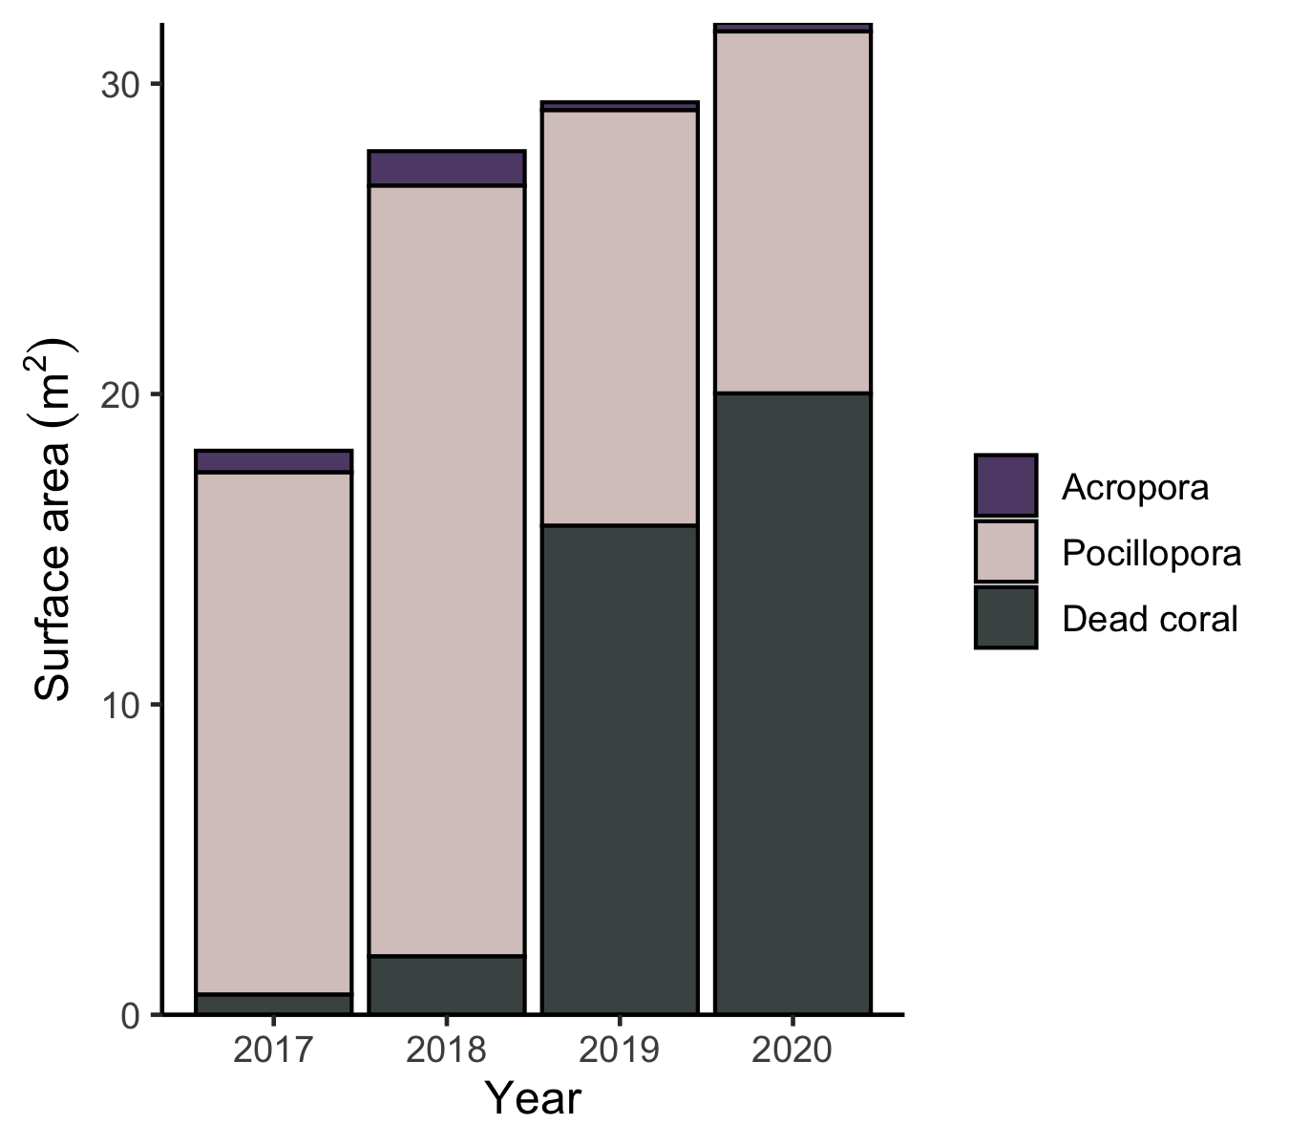
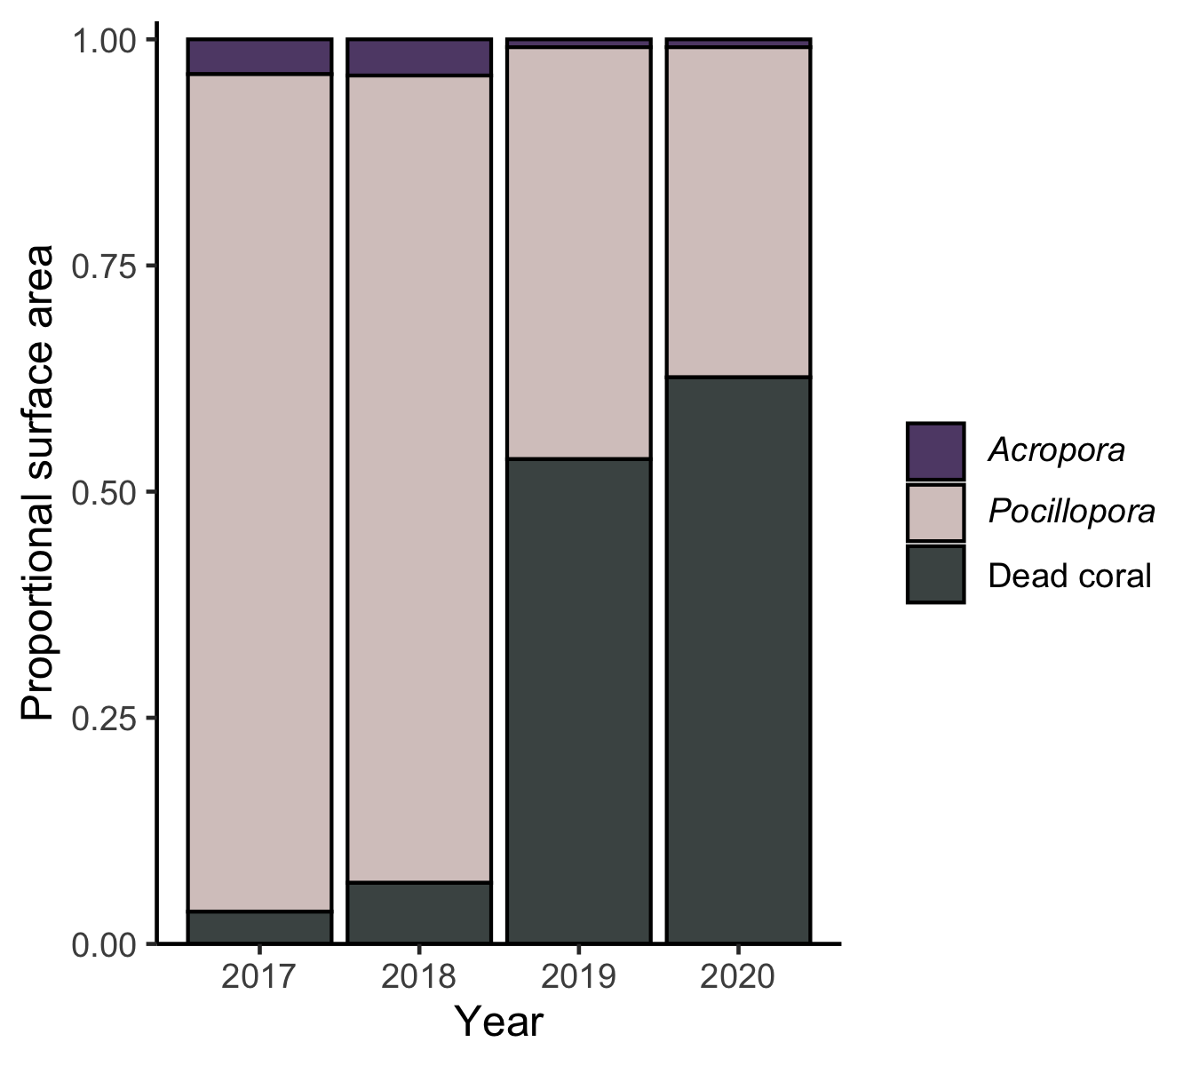
Figure 4
a)
b)
Before heat wave
After heat wave
Before heat wave
After heat wave
Year

Slide 7
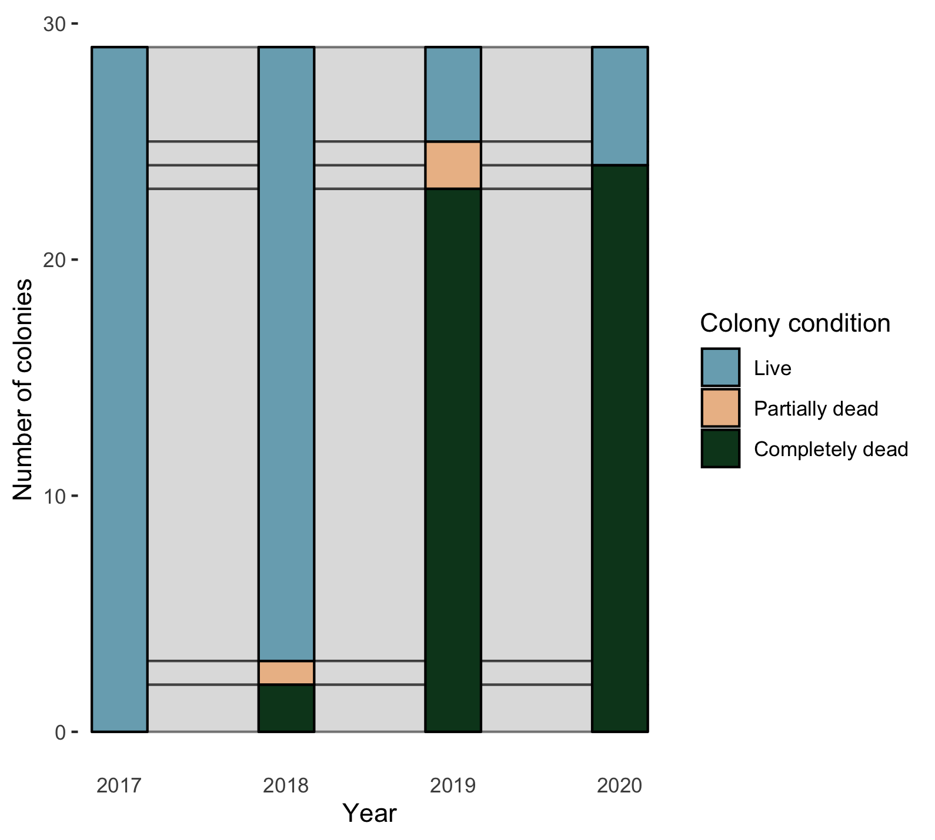
Acropora

